Slide 1

FoodNet: Food Recognition using Deep Learning
An end-to-end AI-powered web application for food image classification and intelligent analysis

Slide 2


CHALLENGE
The Problem We're Solving
Why Food Recognition Matters
Current System Gaps
Food image recognition powers next-generation applications in nutrition tracking, cooking assistance, and smart health platforms. Users need more than just predictions—they need actionable insights.
Limited to basic classification only
No model comparison capabilities
Missing deployment optimization
Lack of contextual information
Our challenge: Build a system that is accurate, fast, deployable, and genuinely informative for end users

Slide 3




Introducing FoodNet
FoodNet transforms food image recognition from simple classification into a comprehensive intelligence platform. Users upload images, select from multiple trained CNN models, and receive real-time predictions enhanced with confidence scores, nutritional data, AI-generated insights, and cooking video recommendations.
Upload & Classify
Model Selection
Real-time food image recognition
Choose from multiple CNN architectures
Smart Insights
Learn More
Nutrition data and AI descriptions
Curated cooking video recommendations

Slide 4





ARCHITECTURE
System Architecture & Pipeline
Image Upload
User uploads food image via Streamlit interface
Preprocessing
Image normalization and model selection
Enhancement
Nutrition lookup, LLM insights, video retrieval
Results Display
Comprehensive output in web interface
Frontend Technology
Backend Technology
Streamlit powers the interactive web interface with session state management for smooth user experience
PyTorch + ONNX Runtime enables efficient model training and optimized production inference

Slide 5



Three Model Architectures
LeNet64
Lightweight CNN designed for speed. Processes 64×64 images with fast inference times, making it ideal for low-resource environments and edge deployment scenarios.
TinyVGG
VGG-inspired architecture striking the perfect balance. Incorporates BatchNorm and Dropout for regularization while maintaining reasonable computational requirements.
ResNet18
Transfer learning champion. Pretrained on ImageNet and fine-tuned for food classification, delivering the highest accuracy among all models tested.

Slide 6

DATA PIPELINE
Training Pipeline & Dataset
Food-101 Dataset Subset
We trained on three diverse food classes from the Food-101 dataset: Pizza, Steak, and Sushi. These categories provide varied visual complexity and real-world applicability.
01
02
03
Exploratory Data Analysis
Model Training
ONNX Conversion
Dataset inspection and visualization
PyTorch-based training with validation
Export models for optimized inference
Why ONNX? ONNX Runtime delivers faster inference, enables cross-platform deployment, and provides hardware acceleration support for production environments.

Slide 7
Optimized Inference Engine
ONNX Runtime
Numerical Stability
Low Latency
Hardware-agnostic inference with GPU (CUDA) acceleration and automatic CPU fallback
Robust softmax implementation ensuring accurate probability distributions
Sub-second prediction times for real-time user interaction
Production-First Design
FoodNet prioritizes inference optimization over training complexity. Our engineering approach focuses on what matters in production: speed, reliability, and user experience.

Slide 8
Comprehensive Feature Set
Real-Time Classification
Nutritional Intelligence
AI-Generated Insights
Video Recommendations
Instant predictions with confidence visualization through interactive probability charts
Detailed nutritional data per 100g including calories, macros, and key micronutrients
Natural language descriptions powered by Groq LLM providing context and details
Curated YouTube cooking videos matched to the identified food type

Slide 9

ENGINEERING
Deployment & System Design
Production-Ready Architecture
Streamlit Frontend
FoodNet is built with scalability and maintainability at its core. The modular project structure separates concerns cleanly, while Streamlit provides an intuitive web interface with sophisticated session state management.
Interactive web application
Modular Backend
Key Design Principles
Organized, maintainable codebase
Clean separation of models, utilities, and configuration
Environment-based API key handling for security
Extensible architecture for future enhancements
API Integration
Session state management for seamless UX
Groq LLM + YouTube Data API

Slide 10
Results, Impact & Future Vision
Challenges Overcome
Key Achievements
Limited compute resources requiring strategic optimization
Multi-model food classification system with 3 CNN architectures
Training scope constrained to 3 food classes initially
ONNX-optimized inference for production deployment
Balancing model complexity with inference speed
Seamless integration of computer vision, LLMs, and external APIs
End-to-end pipeline from upload to actionable insights
Future Roadmap
Full Food-101 Support
Model Explainability
Expand to all 101 food categories
Integrate Grad-CAM visualization
Mobile Deployment
Cloud Scaling
Native iOS and Android applications
Docker containerization and cloud infrastructure

Slide 11
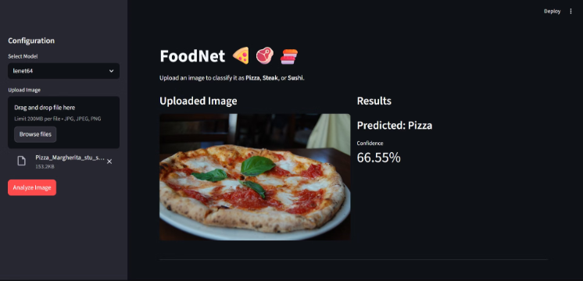
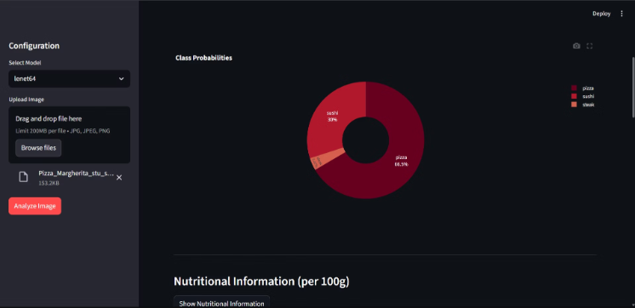
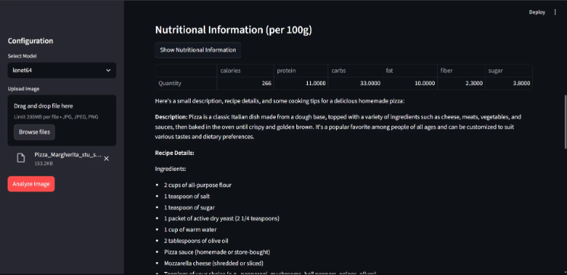
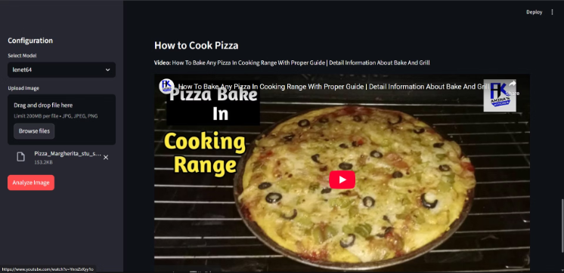
User Interface
Conclusion
FoodNet demonstrates a production-ready approach to intelligent food recognition, combining accuracy, speed, and user value. It provides a strong foundation for real-world applications in nutrition, health, and culinary technology.

